Slide 1

Chatbot Proposal
Che’ Cobb
Southern Methodist Univ.
4/13/2020

Slide 2
Summary of Methods
Rising challenges in the external environment and
Recommended to deploy Chatbot in the healthcare organizations
Increased demand of higher interaction in the healthcare sector
Not enough staff available to provide answers to queries of patients
Even general people asking too many questions of COVID-19
Notes:
.

Slide 3
Summary of Methods
A normal application having an application layer along with a database and an API (Al Rasyid et al., 2020).
Working like an interface to the end users
For example, Mitsuku or Scripted chatbot
Providing responses to the queries posted by customers or patients
Performing like a conversation machine that is designed through Machine Learning models
There are different types of chatbot available in the market (Anirudha et al., 2019)

Slide 4
Problems Anticipated
Determine - type of patients and people that they can expect in the conversation, number of bot sessions that might be required, type of queries that they can expect about COVID-19 and also the fact sheet information that they will need to supply during these interactions.
Difficult for the team to incorporate all the information
In addition, if the chatbot is not secured from the perspectives of security measures like Two Factor Authentication, Biometric Authentication, and End-to-End encryption, will be prone to security challenges in a given environment
Focus more on design aspects of chatbot

Slide 5
Problems Anticipated
Costs associated with it and hence maintenance will pose a challenge
Healthcare staff need to fetch inputs of the patients and then transfer it to the IT team
Other challenges include - way of texting by the users, language of the users, limitations of Natural Language Processing (NLP), and recognition of intents of the users.

Slide 6
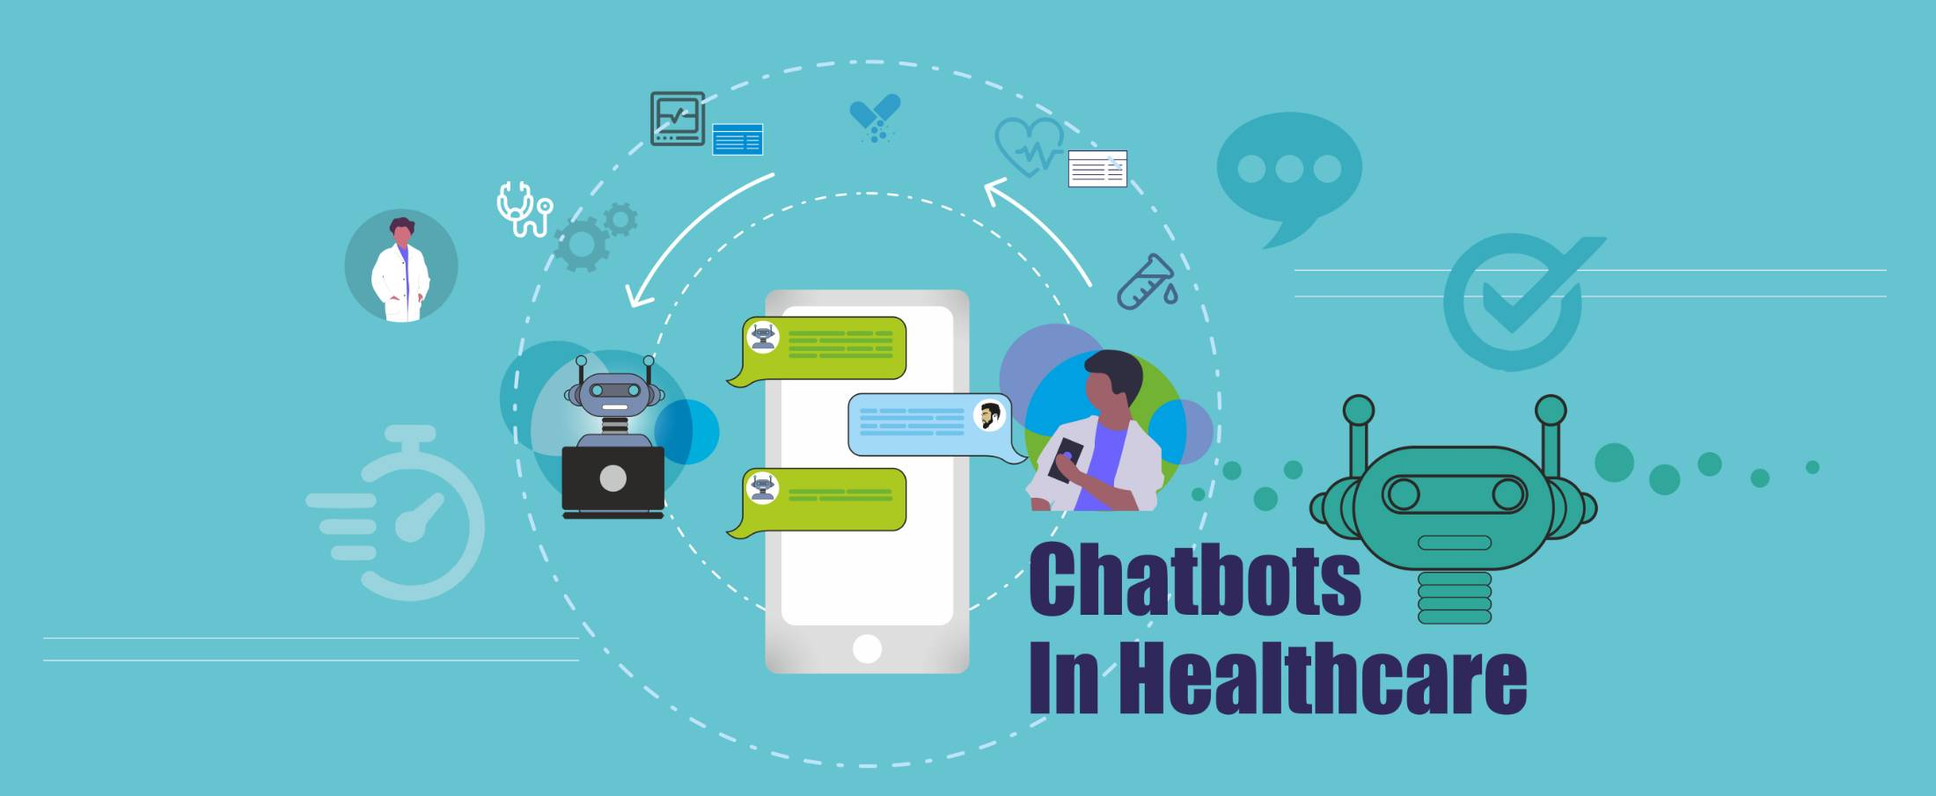

Slide 7
Benefits of Chatbot
Key benefits of using a chatbot include - increasing engagement levels of patients and other people, reducing operational costs in solving queries of the patients, improving patient satisfaction levels, and availability round the clock, handling multiple tasks together, and also streamlining the functional processes of the organization
Make sure of resolving the complaints quickly, ensuring easy communication, and also providing detailed answers to the patients.

Slide 8
Benefits of Chatbot
Total price of chatbot will include - software, application, database management, and also security maintenance
Important for the healthcare organizations to take these aspects into consideration
Thus, the top-level management will need to carry out costs-benefits analysis before finalizing for their organization and thereby responding to queries of COVID-19
They can then select the best application

